Slide 1
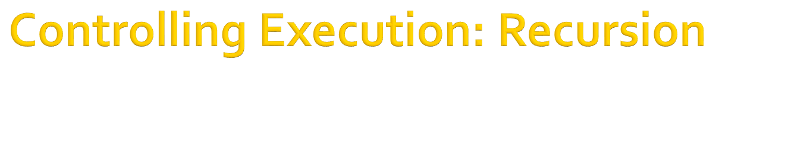
Chapter 8

Slide 2

Recursion is a technique in which something is defined in terms of itself, In prolog recursion is the technique of using a clause to invoke a copy of itself.

Slide 3

Goal: count(1)
1 2 3 4 5 6 7 8 Yes
Goal
predicates
count(integer)
go
clauses
count(9).
count(N):-
write(" ",N),nl,
NN=N+1,
count(NN).

Slide 4

repeat.
repeat:-
repeat.
used to setup a recursion loop
not a built-in predicate
repeat always succeeds (through clause or rule)
The repeat predicate is useful for forcing a program to generate alternate solutions through backtracking.
abc.
abc:-
abc.

Slide 5
A login routine

Slide 6
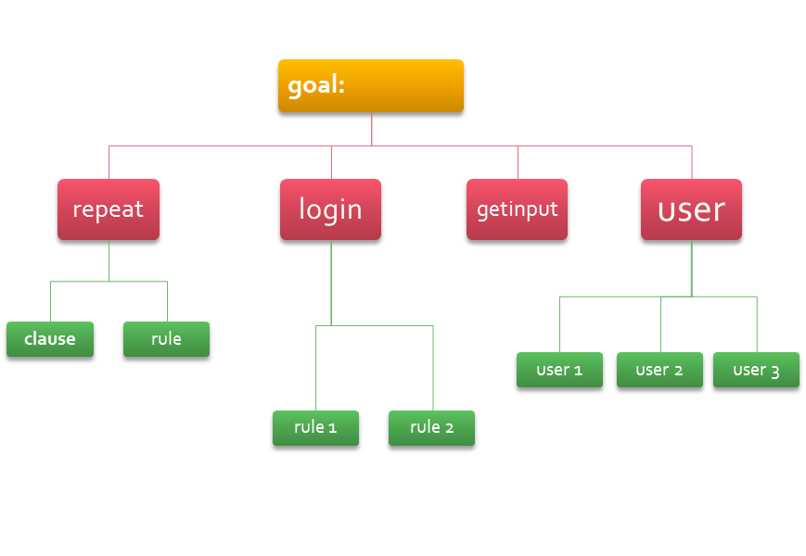
domains
name,password=symbol
predicates
getinput(name,password)
logon
user(name,password)
repeat
clauses
repeat.
repeat:-
repeat.
logon:-
  clearwindow,
  getinput(_,_),
  write("you are successfuly logged on"),nl.
logon:-
repeat,
write("you are not authorized to access"),nl,
getinput(_,_),
write("you are successfuly logged on"),nl.
getinput(Name,Password):-
write("Enter your name : "),
readln(Name),nl,
write("Enter your password : "),
readln(Password),nl,
user(Name,Password).
user(john,john123).
user(sue,sue123).
user(bill,bill123).

Slide 7
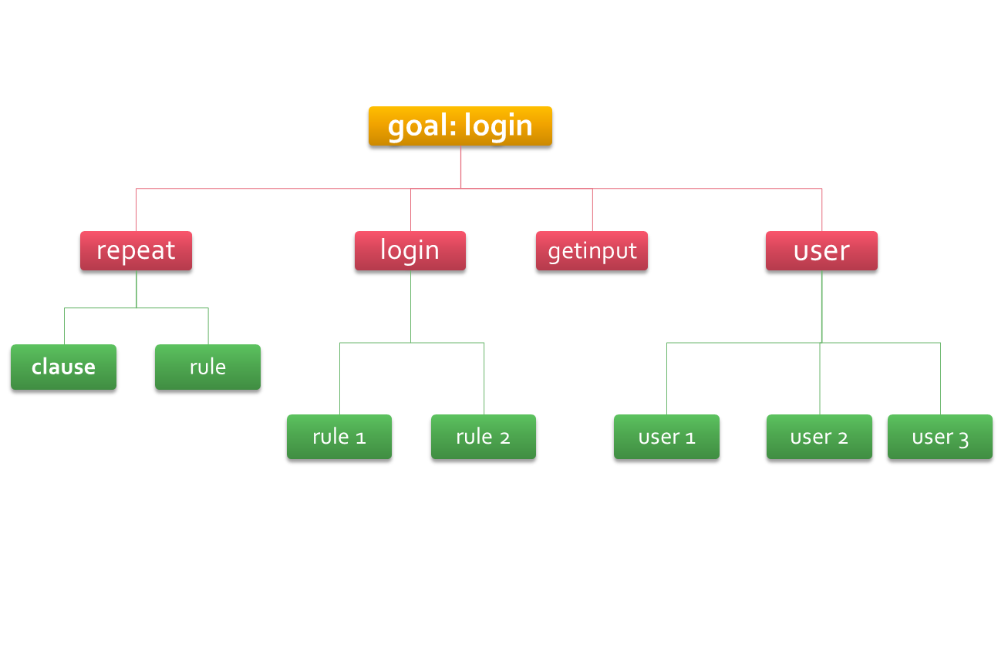

Slide 8
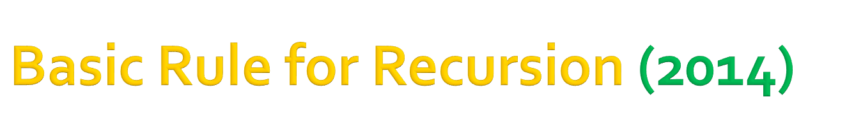
Rule 1:
A program must include some method of terminating the recursion loop
predicate
  count(integer)
  clauses
  count(N):-
  write(“ ”, Last),
  NN=N+1,
  count(NN),
  write( “ you will never get here” ).

Slide 9

Rule 2:
variable binding in a rule or fact applies only to the current layer.
  Goal: count(1)
  Output:
  1 2 3 4 5 6 7 8 You made it here. Layer 8
  You made it here. Layer 7
  You made it here. Layer 6
  You made it here. Layer 5
  You made it here. Layer 4
  You made it here. Layer 3
  You made it here. Layer 2
  You made it here. Layer 1
  Yes
predicate
  count(integer)
  clauses
  count(9).
  count(N):-
  write(“ ”, N),
  NN=N+1,
  count(NN),
  write( “ you made it here. Layer”, N),nl.

Slide 10
Rule 3:
In most application, the recursion should do its work on the way down

Slide 11

Not always the best programming choice
  Complex
  Flow of execution is not easy to follow
  Requires more memory
Should keep the number of variable and use of complex structure to a minimum
If required to force backtracking use “fail” predicate instead (See. Ch-7)

Slide 12
End of Slide

